Slide 1






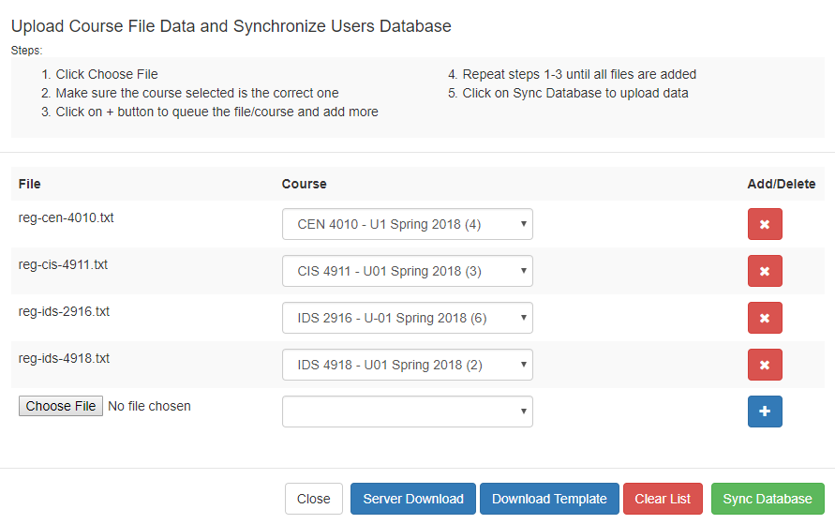
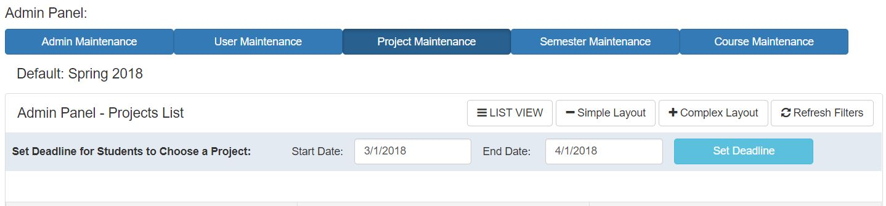

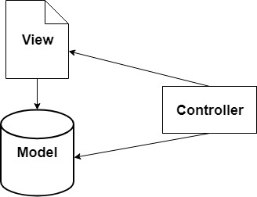
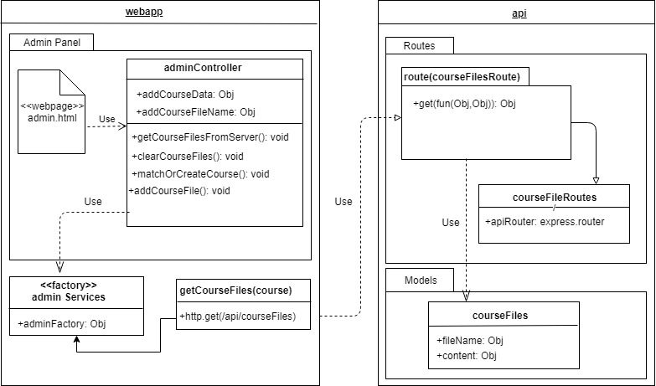
School of Computing & Information Sciences
VIP Senior, 2018, Spring
VIP Website 8.0
Student: David Venta, Florida International University
Professor: Masoud Sadjadi, Florida International University
Problem
The import process of multiple course’s data is not automated and is time consuming.
No date restriction to join or drop projects.
Some pages are not mobile compatible.
Solution
PantherSoft file’s data is populated from the server into VIP website automatically.
Implement setting parameters that restrict students to an specific date range for selecting projects.
Make frequently visited pages mobile compatible.
Current System
Course import is done by manually browsing, downloading and uploading files.
Students are allowed to join or drop projects anytime during semester.
Useful descriptions of projects hidden and cluttered login page.
Screenshots
Fig.2: Start and end date to set a restriction to join or drop projects.
Fig.1: Upload Course feature with files populated from server.
Requirements
Admin ability to automatically populate course’s files from server and /upload/import data to VIP website.
Restrict users to join or drop from a project to a specific date range.
Make frequently visited pages mobile friendly.
System Design
The system employs the Model-View-Controller(MVC) architecture, as shown below:
Implementation:
MongoDB – NoSQL Database
Express – App Framework
AngularJS – Front-end framework
NodeJS – JavaScript Runtime
The MEAN stack was used for the development of this website.
Verification
Local testing done manually using unit testing.
Local testing of areas/features done manually using integration tests.
Object Design
Summary
Improved time efficiency and effort to import user’s data from the server.
Users are restricted to a time frame established by the Admin to join/drop projects.
Most frequently visited pages are now mobile friendly.
Acknowledgement
The material presented in this poster is based upon the work supported by Dr. Francisco Ortega and Dr. Masoud Sadjadi. I am thankful to the help that I received from my group member Sergio H. Padron.
Notes:
1

